Slide 1

Football Analysis
By- Kartik Rastogi

Slide 2
Introduction
Football is a global, popular, and dynamic sport with many different factors that can influence the outcome of a match.
By analyzing large datasets of football data, teams can gain a deeper understanding of factors that contribute to players' success, enabling coaches, scouts, and analysts to make informed decisions.
Football data analysis is the process of collecting, cleaning, and analyzing data to extract meaningful insights.
The valuable insights extracted from this analysis can be used to improve player performance, team tactics, fan engagement, and overall decision-making.

Slide 3
Methodology
Data Preprocessing
The data preprocessing is done in python using various libraries like Numpy, Pandas, and this includes
Data merging
Checking the consistency of dataset
Imputing null values
Removing duplicate rows and columns
Data Merging
The data is given in 5 different sheets and they are merged into three different data frames for most precise analysis without any data loss.
Data cleaning
All the columns in data are checked for null values and are imputed with mean and mode based on the type of data. The duplicate rows are removed and the clean data is exported to MS Excel and Tableau for further analysis

Slide 4
Overview of Data treatment
Data Collection:
Data merging
Data Cleaning:
Data Preparation:
Data Visualization:

Slide 5
Tools
Python:
Pandas library for data manipulation and cleaning.
NumPy for numerical operations and handling missing data.
CSV module for exporting cleaned data to a CSV file.
Tableau:
Powerful visualization software for creating interactive dashboards and visualizations.
Enables seamless integration with cleaned data from Python for in-depth analysis and reporting.

Slide 6
Overview of Key Focus Areas for Analysis
Focus areas:
Performance Analysis
Player Profile & Market Value
Team Comparison
Attendance and Stadium Analysis
Referee Analysis
Event Analysis
Competition Analysis
Player Attributes and Demographics
Contract Management

Slide 7
Business Objectives
Top Goal Scorers: Identify and analyze the top goal scorers across all competitions to understand their impact on the game.
Stadium Attendance: Examine the attendance data for stadiums to gauge fan engagement and popularity of matches.
Player Profile & market value:
Display player position, and market value.
Include interactive player cards with detailed information.
Team Comparison : Evaluate teams who wins and loss based on the number of goals scored
Compare performance metrics between two teams.
Include win-loss records, goals scored, and defensive stats.
Player Attributes and Demographics :
Display distribution of player attributes (age, nationality, height, preferred foot).
Explore correlations between player attributes and performance.
6 Event Analysis:
Visualize key match events (goals, cards) on a timeline.
7 . Referee Analysis:
Evaluate referee performance based on match outcomes and disciplinary actions.

Slide 8
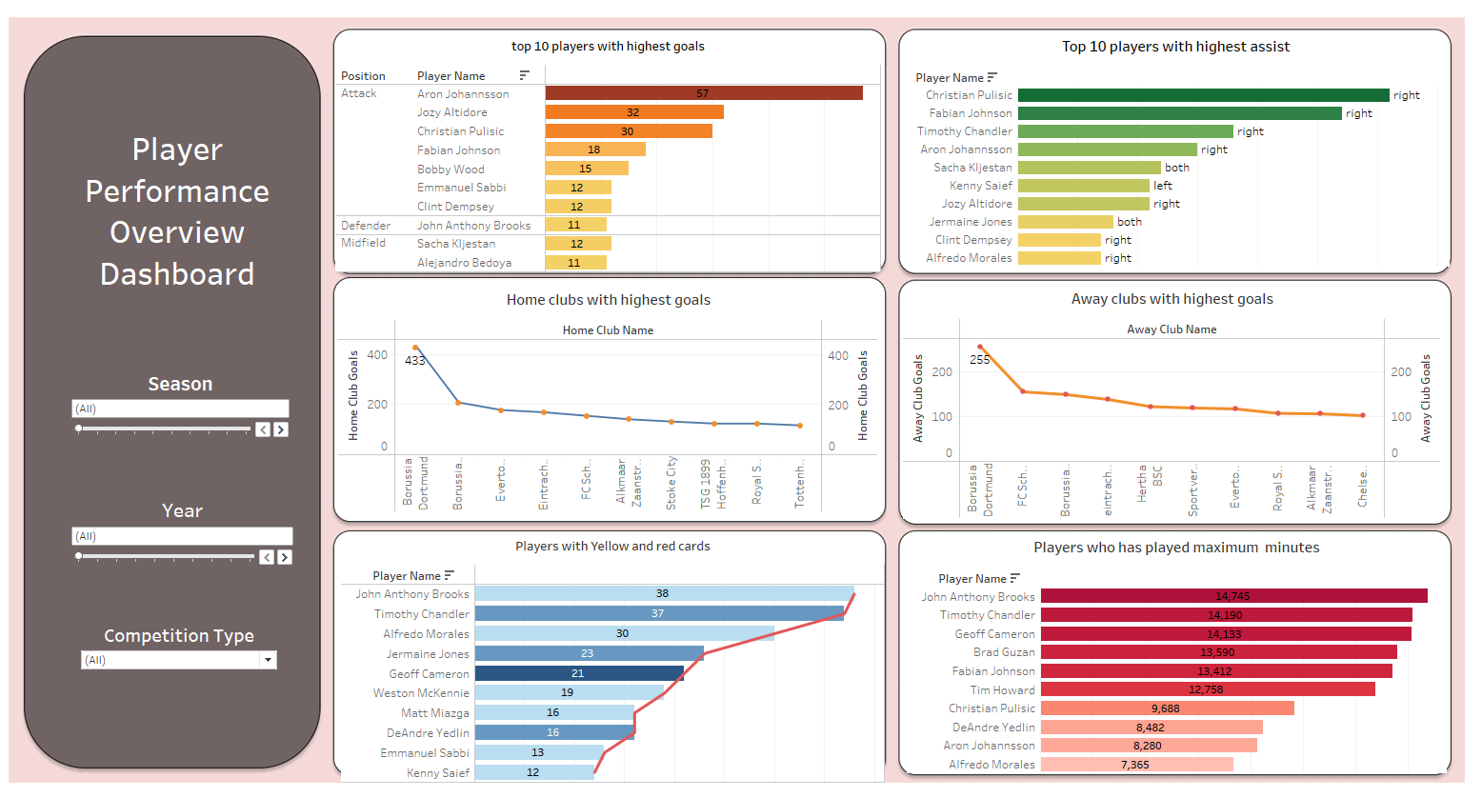
Player Performance Analysis
Aron Johannsson has performed well in goal-scoring prowess, while Christian Pulisic stands out with exceptional in goal-scoring prowess , assists using his preferred right foot for Home club team

Slide 9
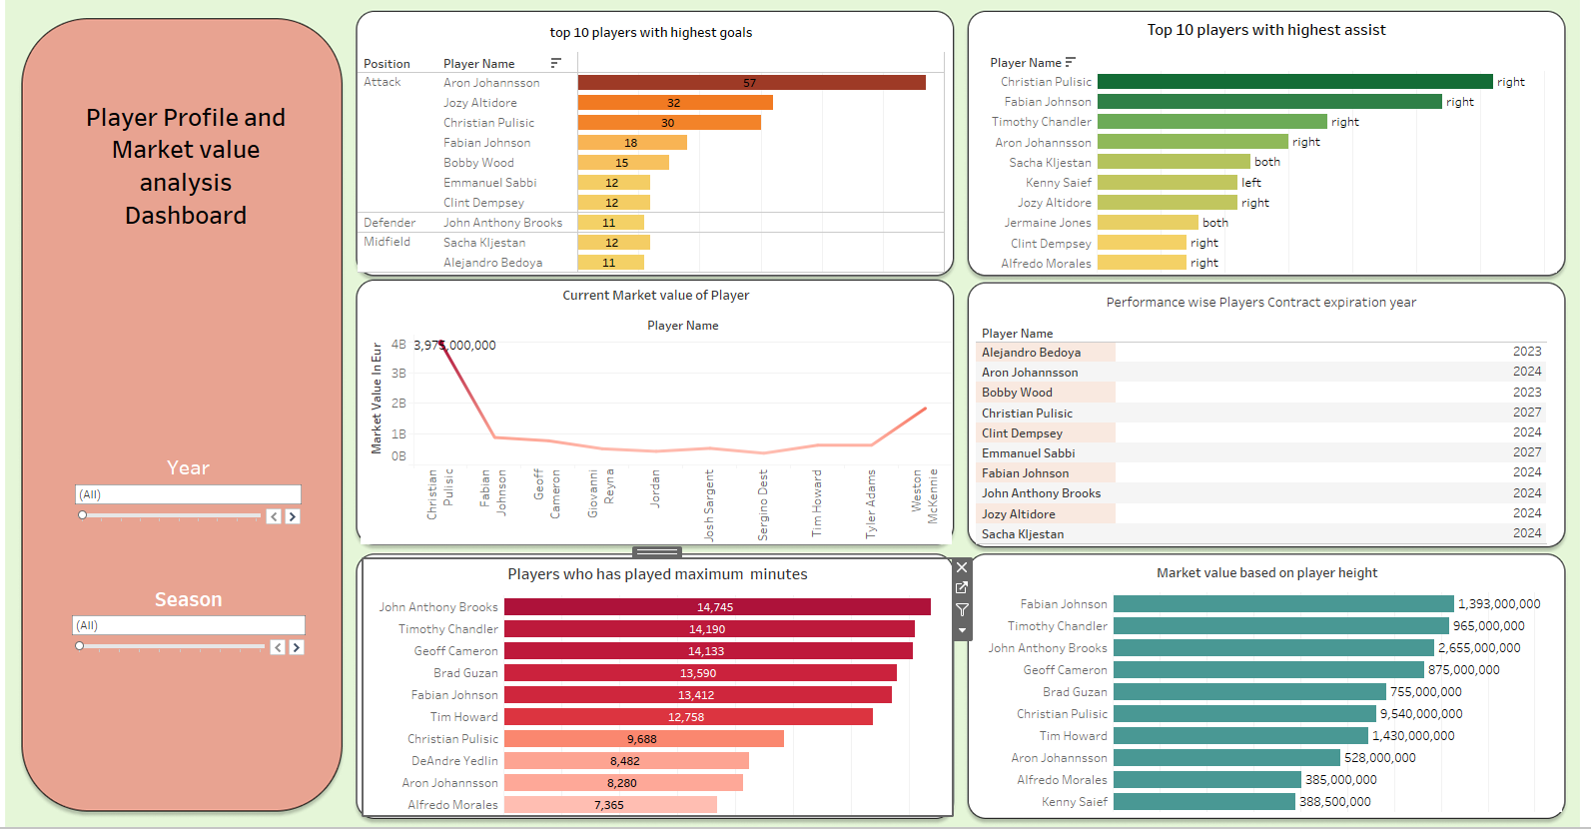
Player Profile and market value
Christian Pulisic has the highest market value

Slide 10
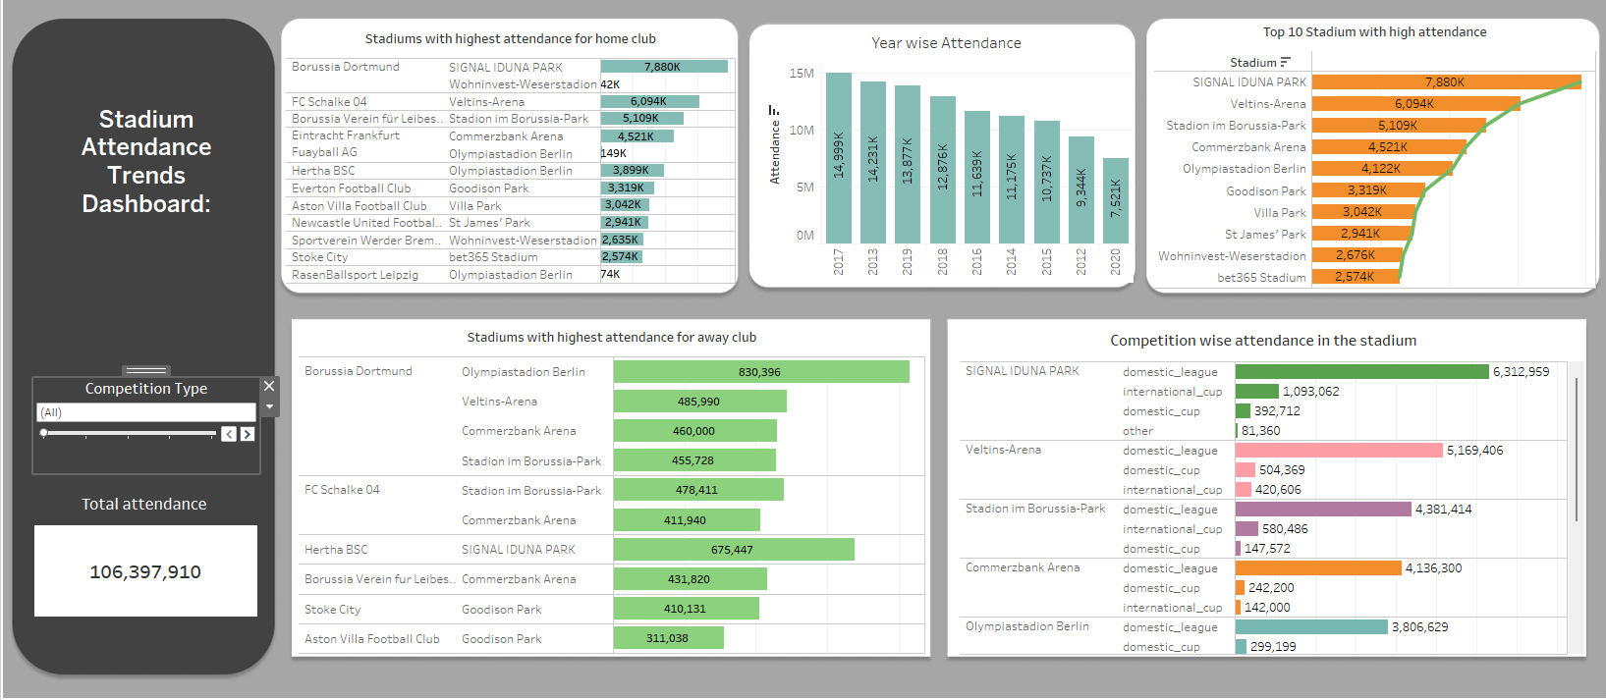
Stadium and Attendance analysis
Signal Iduna Park, home to Borussia Dortmund, boasted the highest attendance figures, witnessing peak overall attendance.

Slide 11
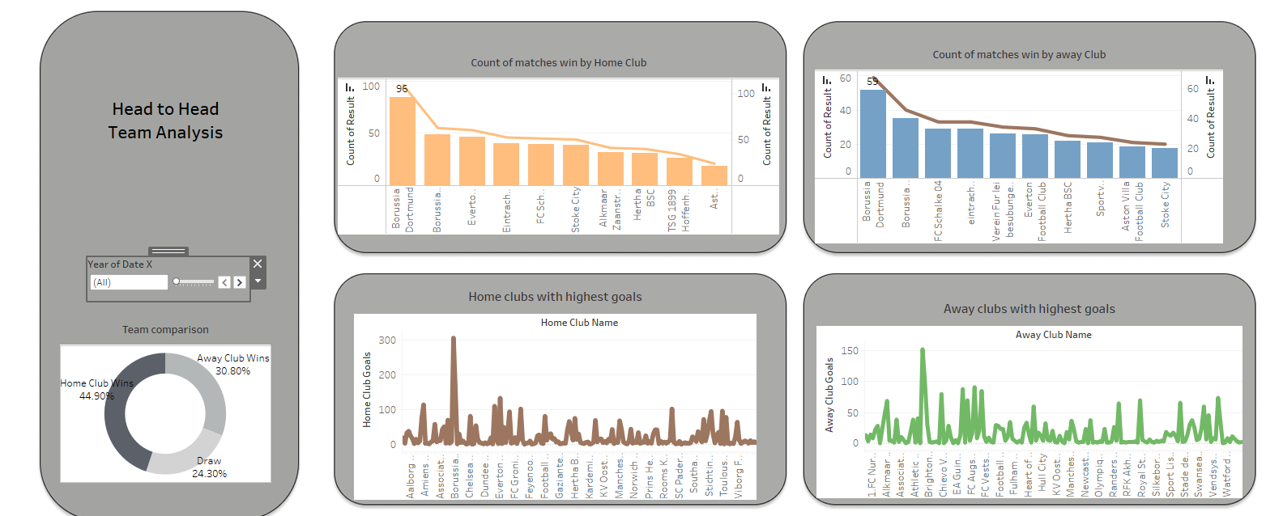
Team comparison
Borussia Dortmund leads in both home and away victories while also topping the charts for highest goal-scoring in matches. This dominance solidifies their position as a formidable force in football, shaping the outcomes of matches significantly.

Slide 12
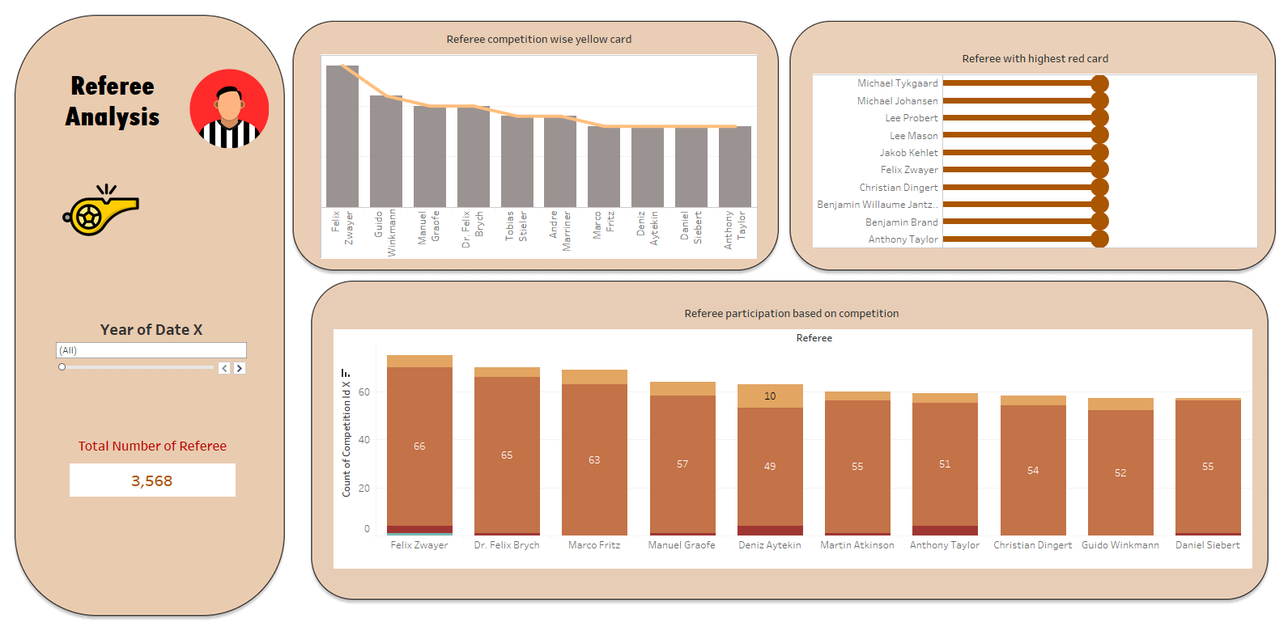
Referee analysis
Felix Zwayer, among 3,568 referees, issued the highest number of yellow cards and one red card

Slide 13
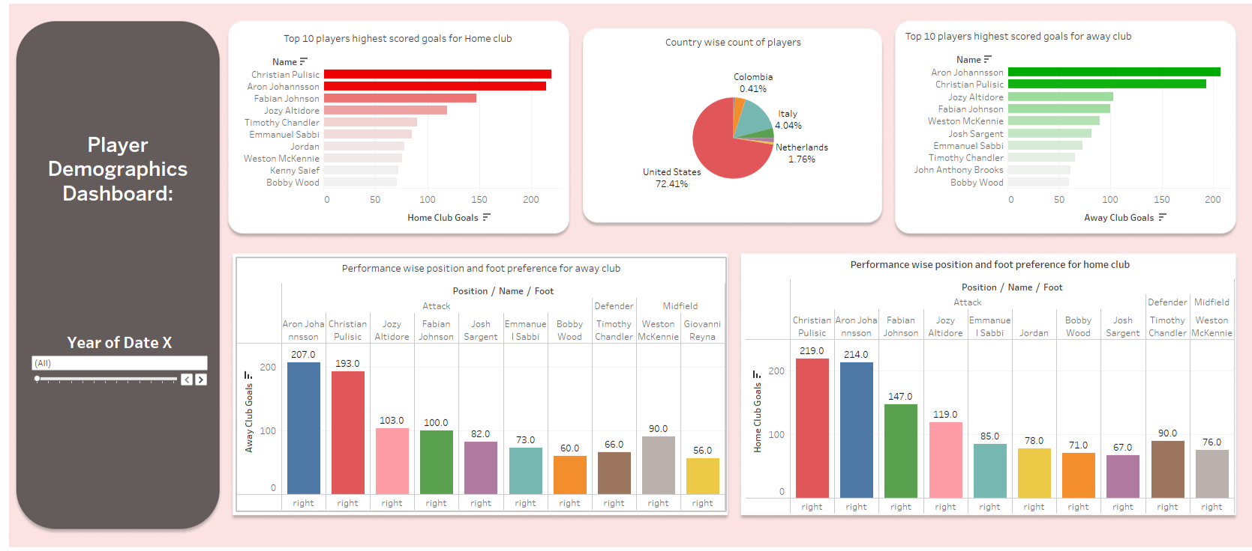
Player Demographics analysis
Most of the Players are from United States , Christian Pulisic has scored highest goals from home club and Aron Johannsson has scored maximum goals for away club

Slide 14
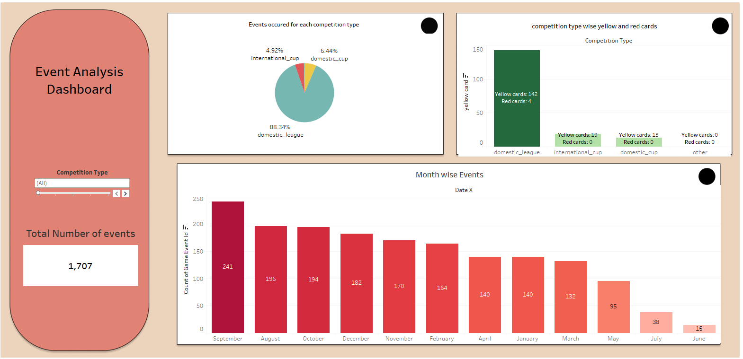
Event Analysis
September emerges as a peak month for football events, particularly within domestic league settings.

Slide 15
Conclusion
Our football analysis has revealed valuable insights that can drive strategic decision-making for clubs and stakeholders. Aron Johannsson has performed well in goal-scoring prowess, while Christian Pulisic stands out with exceptional in goal-scoring prowess , assists using his preferred right foot for Home club team. Borussia Dortmund emerges as a dominant force in goal-scoring, both at home and away, with Signal Iduna Park hosting the highest attendance, especially during domestic league matches. Referee Felix Zwayer's officiating style notably influences match outcomes. September emerges as a peak month for football events, particularly within domestic league settings. These insights provide a roadmap for player development, tactical adaptation, fan engagement strategies, referee management, and seasonal planning to optimize team performance and elevate competitiveness in the dynamic world of football. By leveraging data-driven insights effectively, clubs can navigate challenges, seize opportunities, and excel on the global football stage.

Slide 16
Thank you

